Slide 1

SONARQUBE
Krishna PRASAD

Slide 2
Agenda
STATIC CODE ANALYSIS
What it is
Why do we need it have it
Tools Available
CODE QUALITY
What it is
Why do we need to Measure it
When Should we measure it
Outcomes of Code Inspection

Slide 3
(..Contd)
SONAR QUBE
What it is
Features
How does it work
Core Engine Functionalities
Inside View
Architecture
Installation (Eclipse & Server)
Technical Terms, Metric Definitions
Integration to Jenkins
Managing Violations
Outcome of Session
Demo

Slide 4
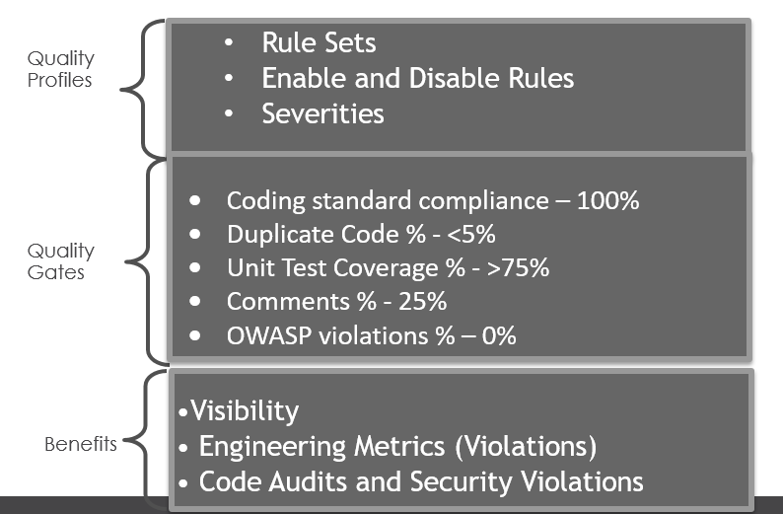
STATIC CODE ANALYSIS
Static analysis, also called static code analysis, is a method of computer program debugging that is done by examining the code without executing the program. The process provides an understanding of the code structure, and can help to ensure that the code adheres to industry standards.

Slide 5
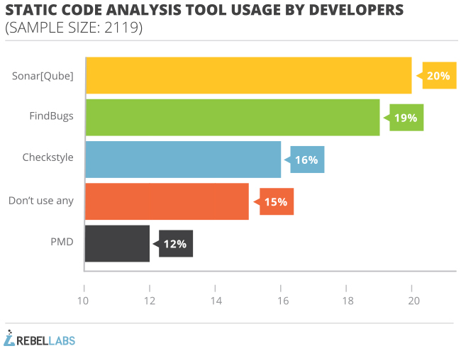

Slide 6
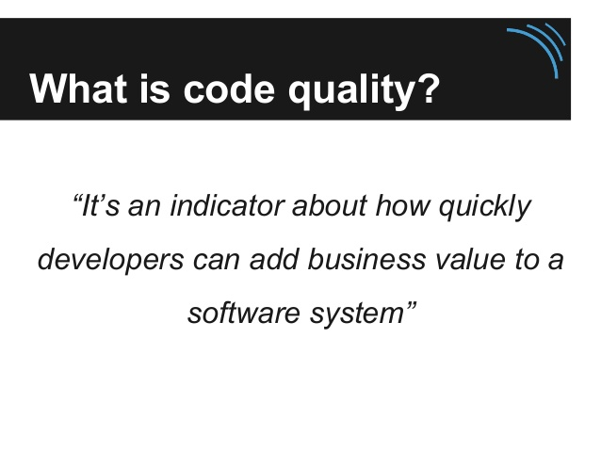

Slide 7
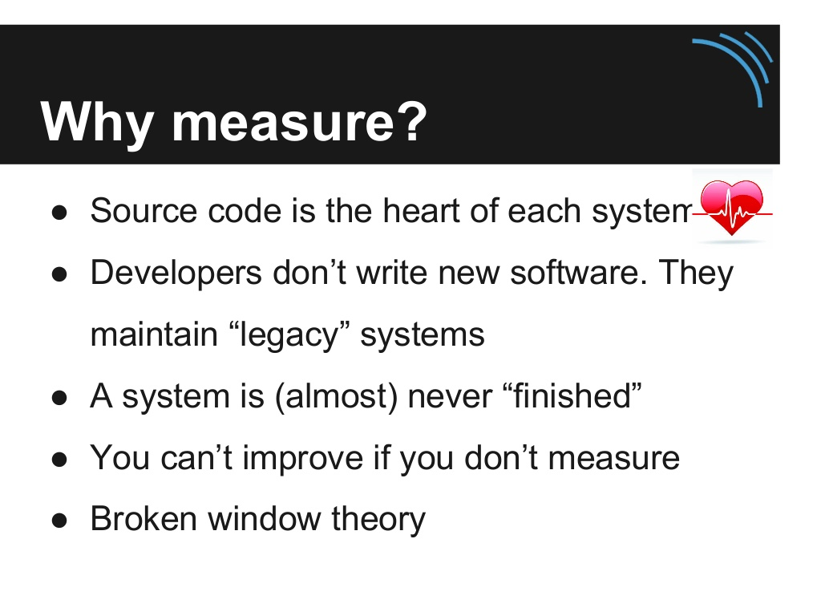

Slide 8
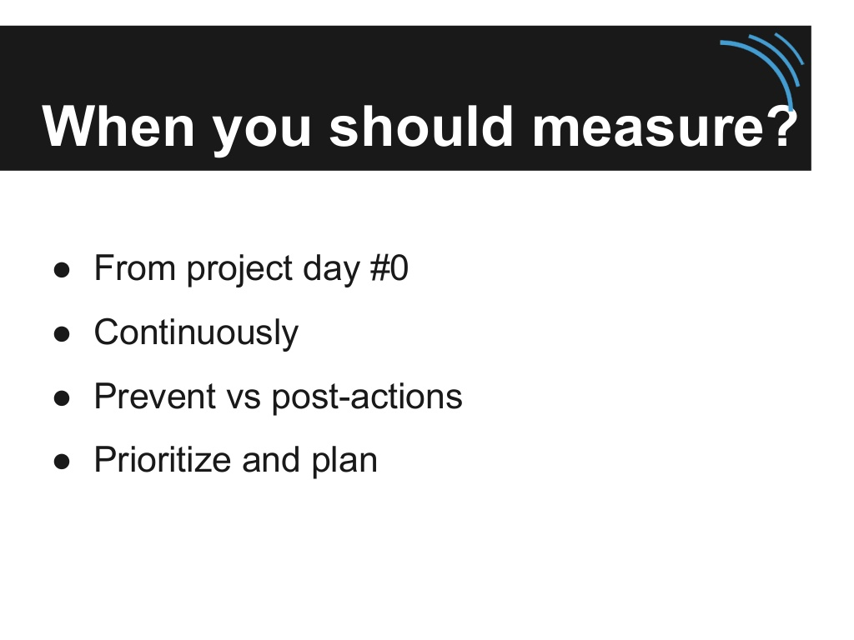

Slide 9
What Results Can You Expect from Inspections?
The combination of design and code inspections usually removes 70-85 percent or more of the defects in a product
Designers and coders learn to improve their work through participating in inspections, and inspections increase productivity by about 20 percent
On a project that uses inspections for design and code, the inspections will take up about 10-15 percent of project budget and will typically reduce overall project cost.

Slide 10
Best Results – Combine Approaches
The typical organization uses a test-heavy defect-removal approach and achieves only about 85 percent defect­ removal efficiency.
Leading organizations use a wider variety of techniques and achieve defect-removal efficiencies of 95 percent or higher.

Slide 11
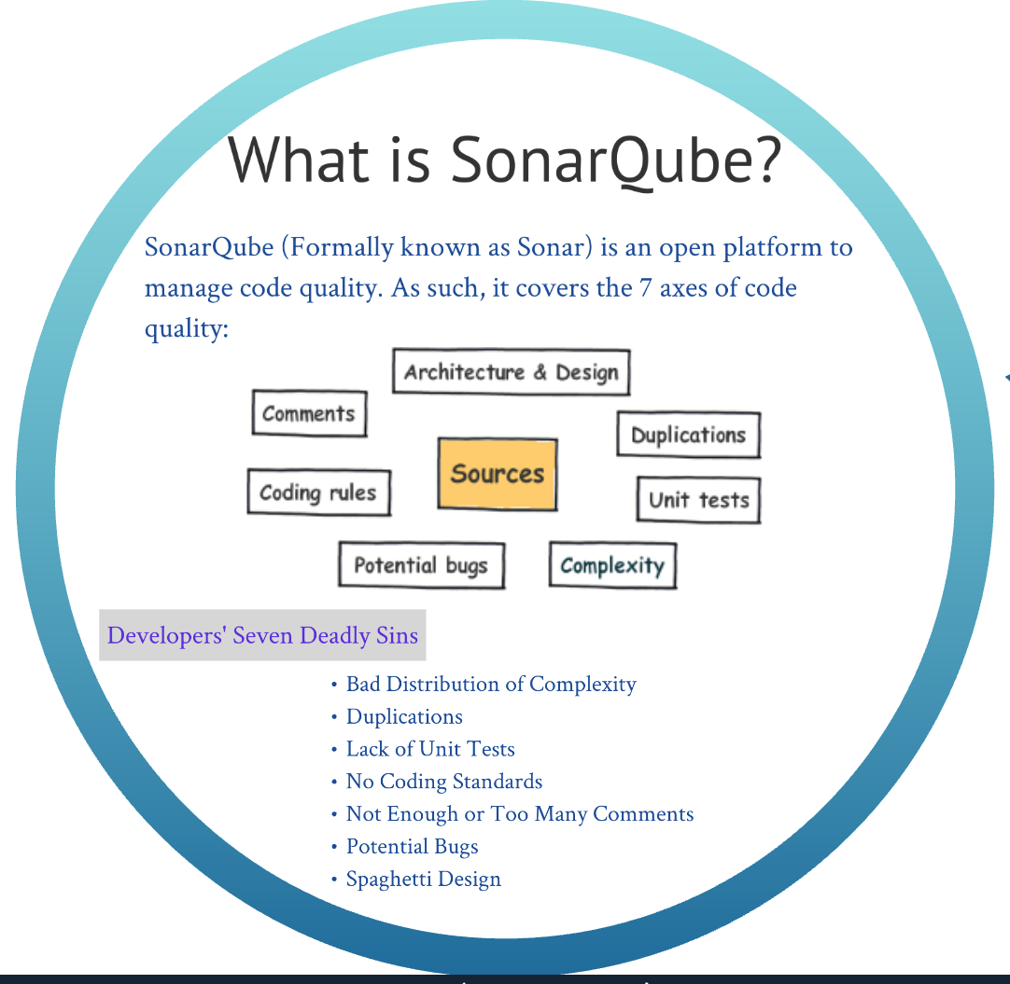
Tracking & Improving Software quality with sonar qube

Slide 12
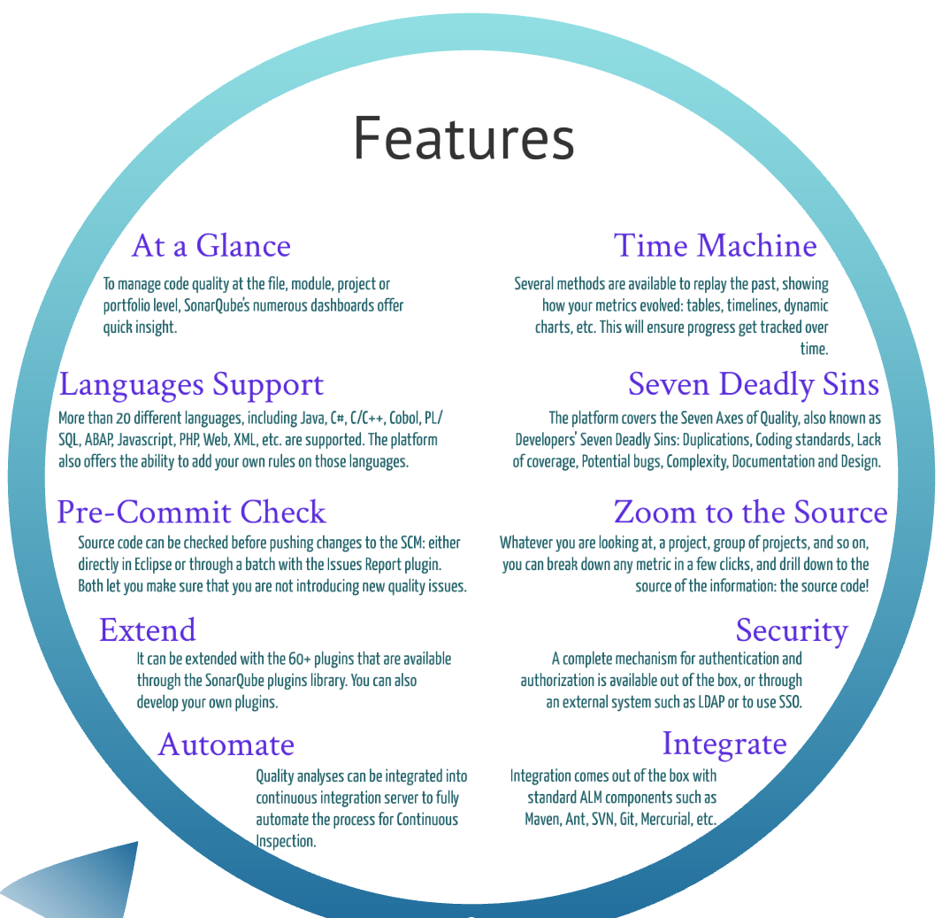

Slide 13
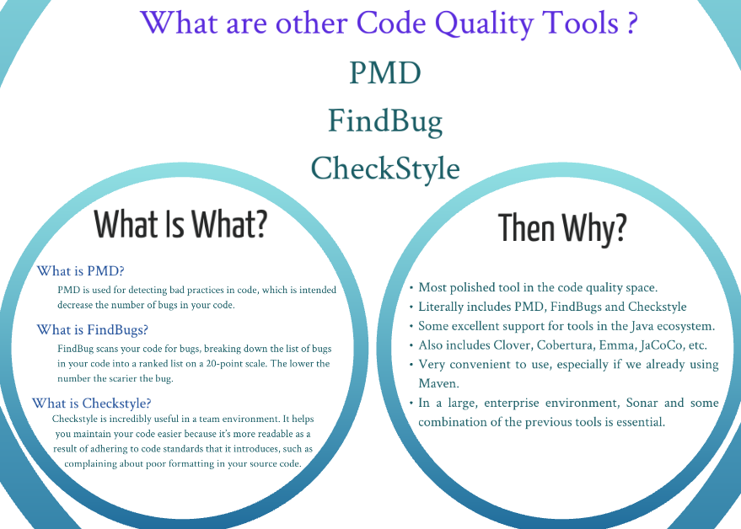

Slide 14
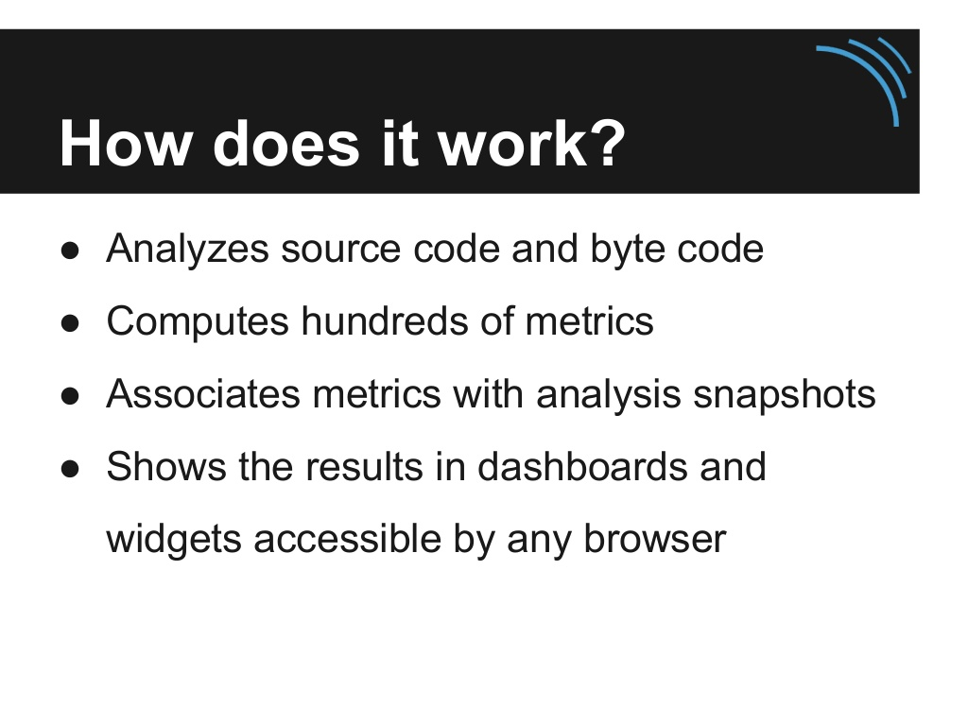

Slide 15
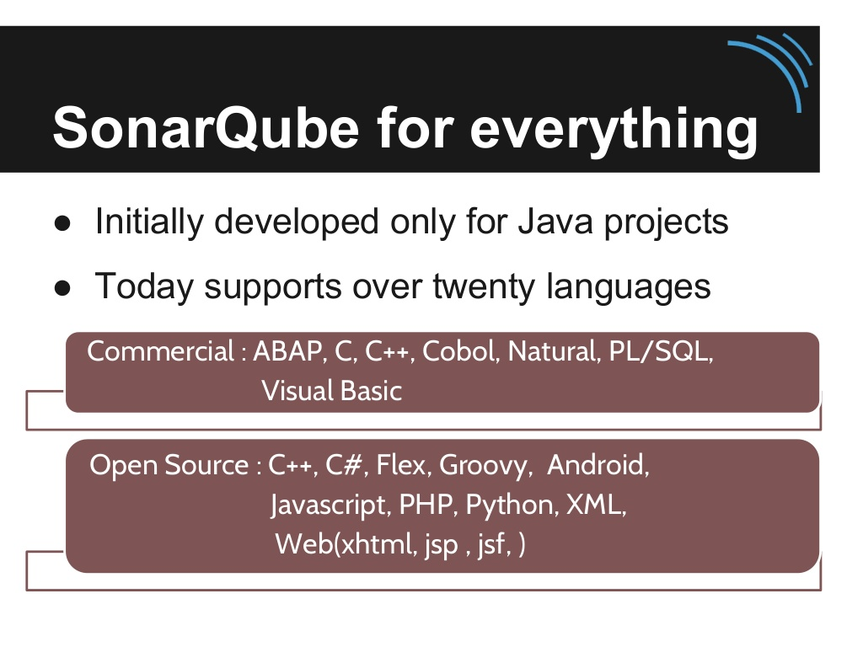

Slide 16
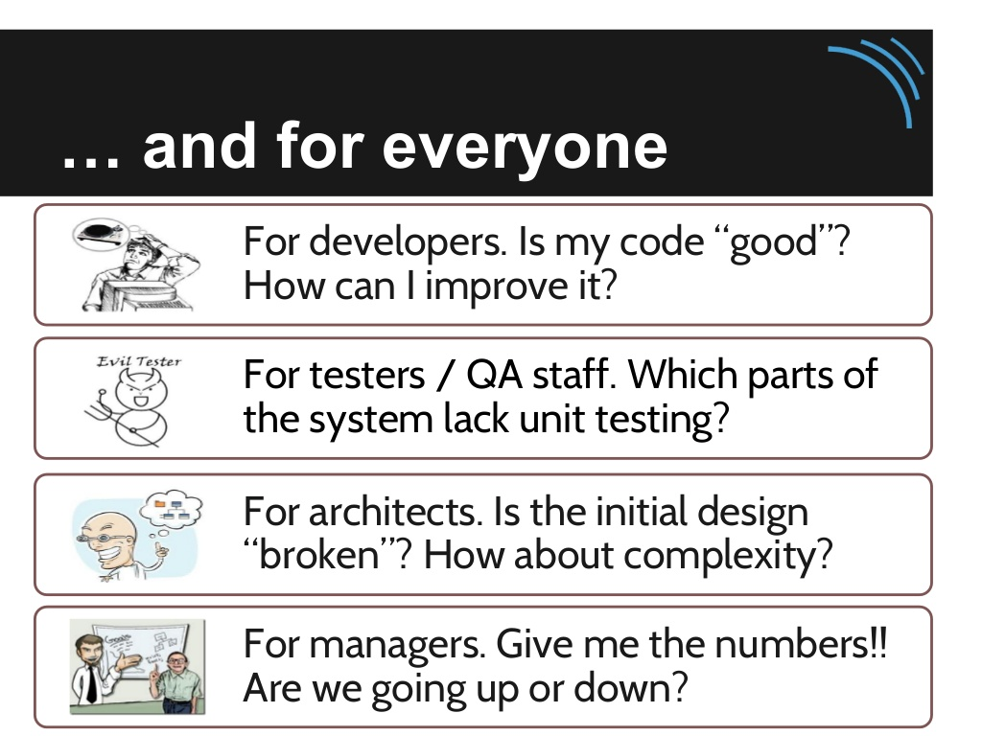

Slide 17
SonarQube Functionalities
Core Engine functionality
Support and Approval Process
How it will analyze the code. (Java, PHP, CSS, HTML, C#, JS, TSQL, PLSQL…etc.)
How it execute and generate the code coverage.
Quality Profiles
Quality Gate
Dashboard widgets
OWASP
Provisioning
Plugins updates and Installations.

Slide 18
Inside View
Benefits
Enforce Clean Code standards
Building on top of Open Source Jenkins & Sonar frameworks
Supports Java, .NET, Mobile (iOS & Android), Ruby, Projects
Unit tests, automated functional tests, test coverage
Automated code quality analysis
Metrics exposed in ALM dashboards
Immediate quality feedback to team and client
Reports
Email on Build Failure / Success (Immediate)
Weekly Code Quality Report
SCM Statistics by Developer
InsideView Engineering Metrics Charts
Sonar Dashboard for drilled down violation details
Escalation notifications
Metrics
Rules Compliance
Engineering Violations
Unit Tests
Code Quality
Unit Test Coverage
Unit tests success/fail
Lines to cover
Technical Debt Ratio
Design Quality

Slide 19
Used by Apache Projects (Maven, Sling, Jackrabbit, ...)
Sonar Source company provides commercial Support and Plugins
A comprehensive Enterprise CI environment to ensure Baked-In Quality with automated builds, code analysis, and test coverage metrics.

Slide 20
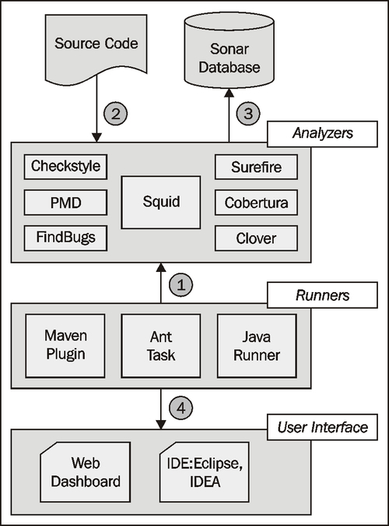
Architecture of Sonar
The core engine of the platform, Squid, is supported by additional code analyzers which Sonar orchestrates together to measure quality.
1. An analysis request is triggered using one of three possible methods:
Maven Plugin
Ant Task
Java Runner
2. Sonar receives the request and starts analyzing the project's source code. The analysis is based on the project's Sonar profile activating any additional plugins or reporting capabilities, if any.
3. When the analysis is over, results are stored to a database for future reference and ...

Slide 21
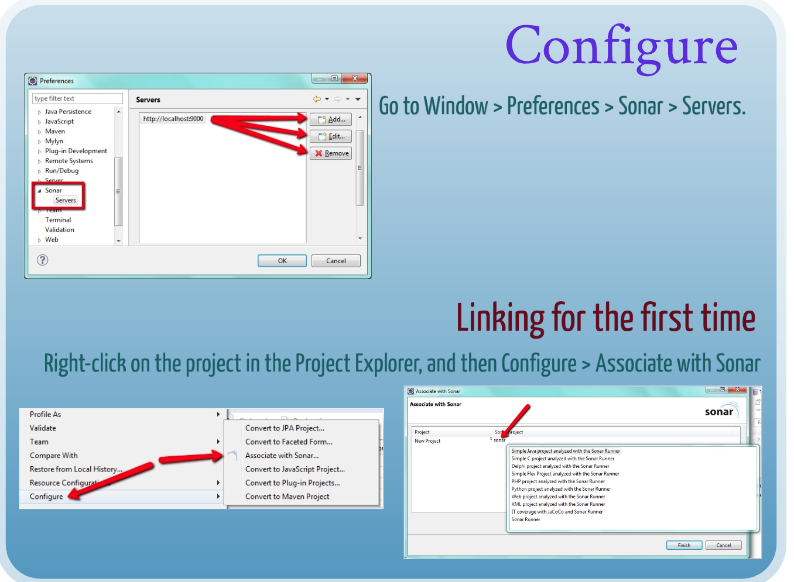
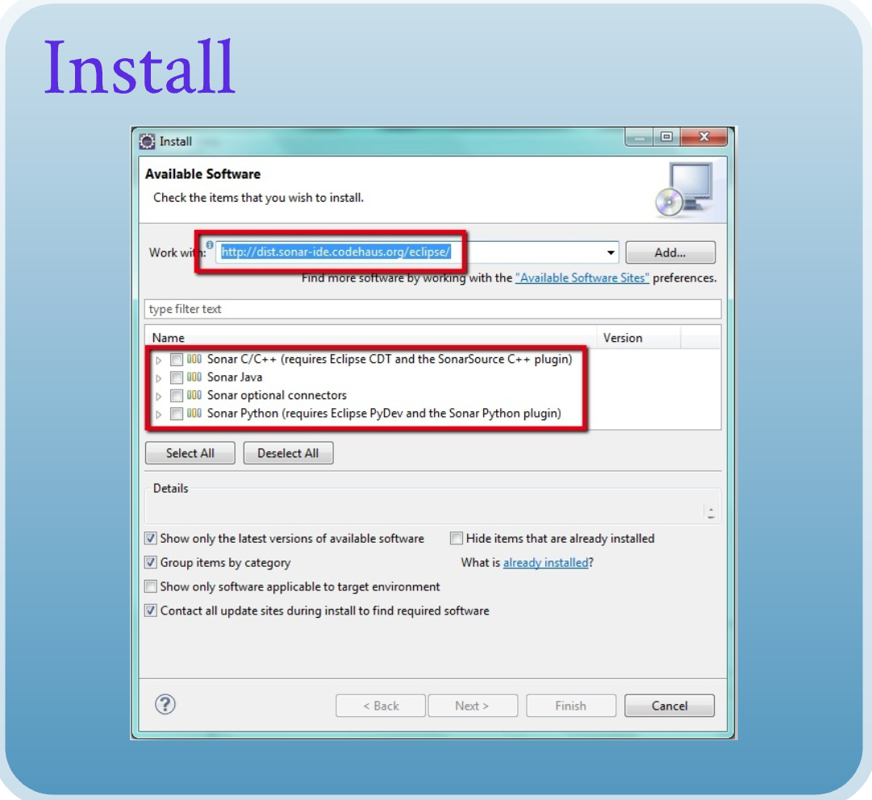
INSTALLATION
Integration into Eclipse

Slide 22
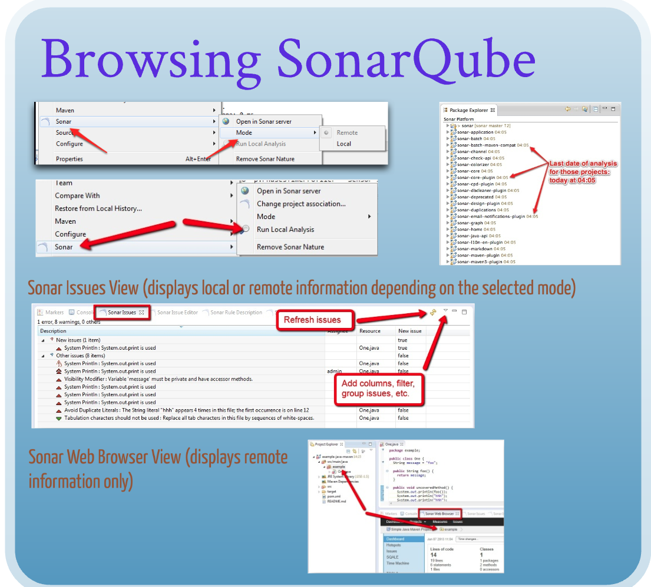
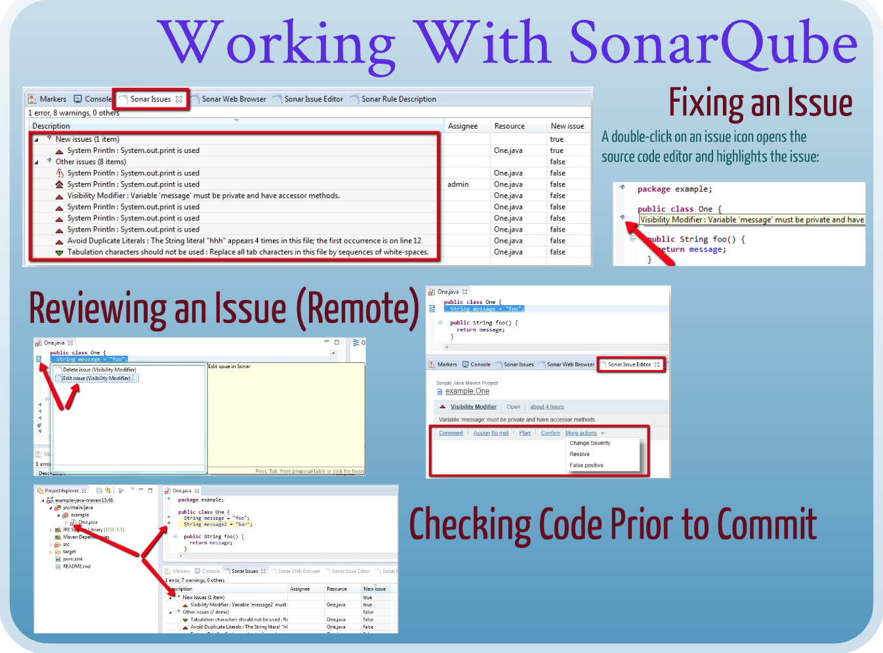
(…Contd)

Slide 23
SERVER INSTALLATION
Server Requirements
OS (Linux or Windows)
§ Java
§ DB (Mysql, PostgreSQL, ...)
§ Server Installation is really simple
§ Update Center
Jenkins Integration
Sonar Qube Add-on's
Build Tools (Ant, Maven & MS Build)

Slide 24
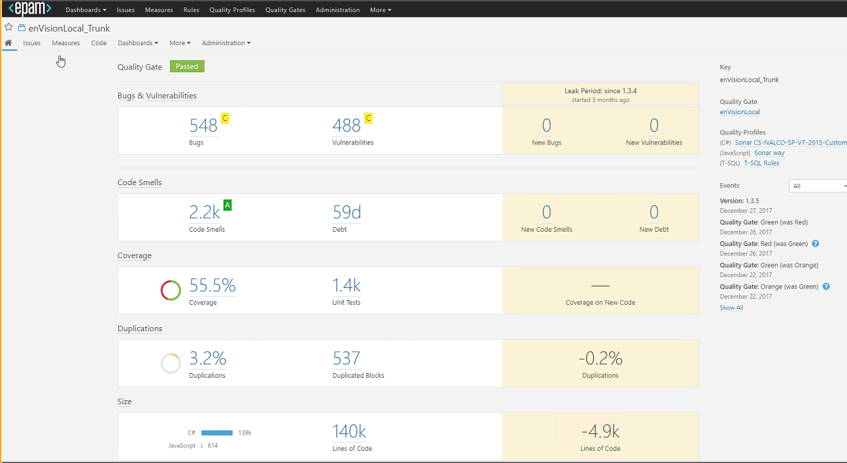

Slide 25
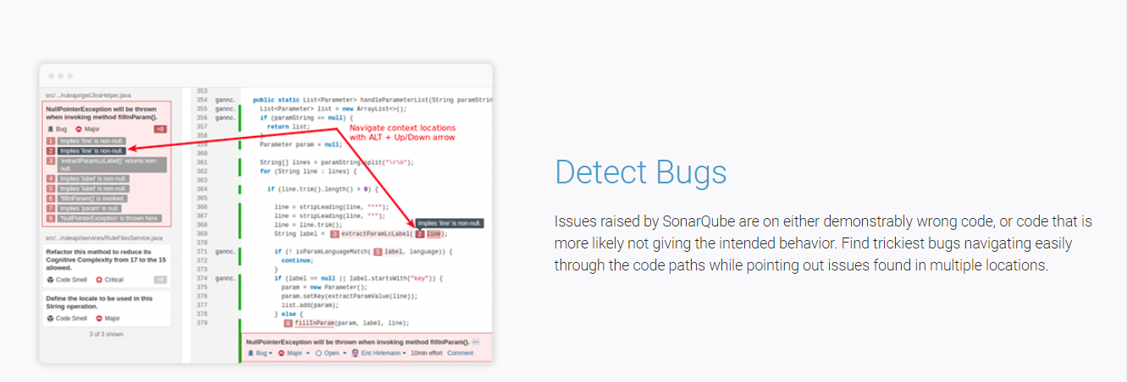

Slide 26
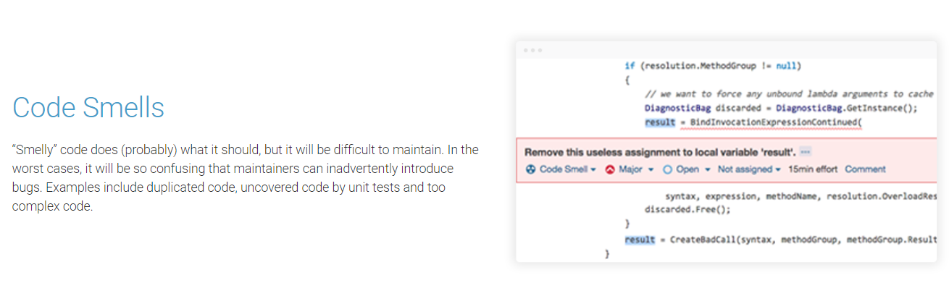

Slide 27
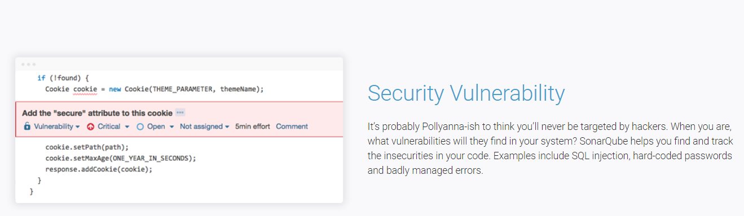

Slide 28
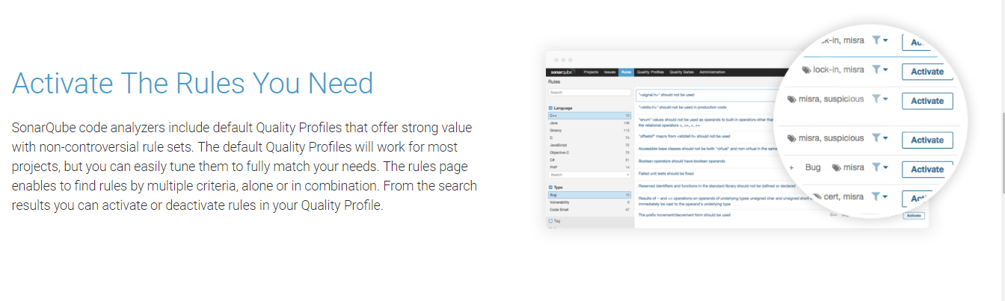

Slide 29
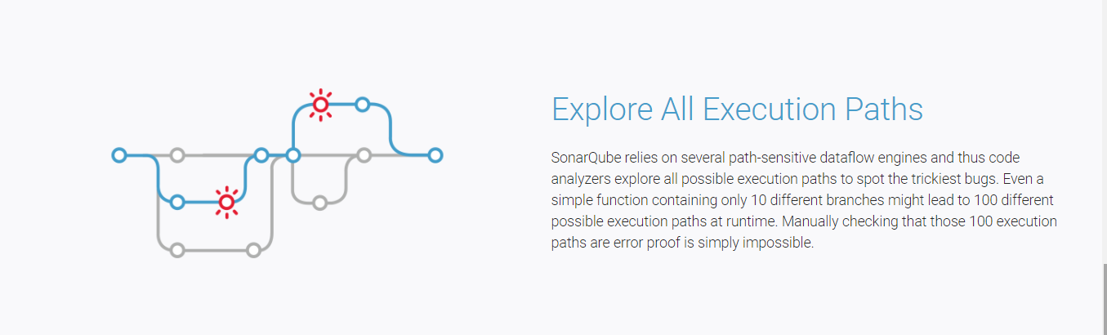

Slide 30
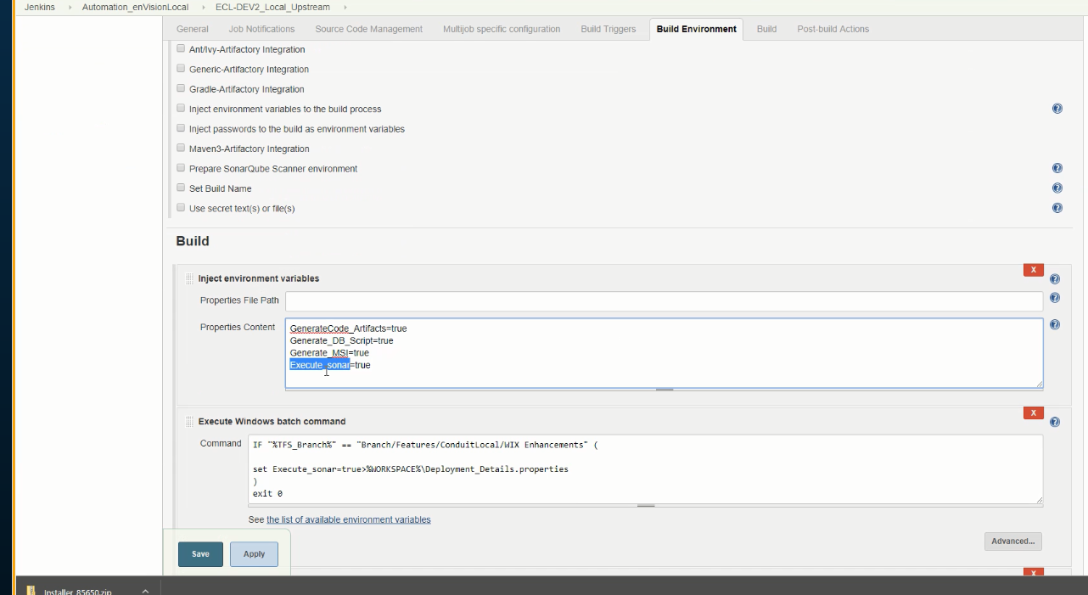
Jenkins Integration & FLOW (SNAPSHOTS)

Slide 31
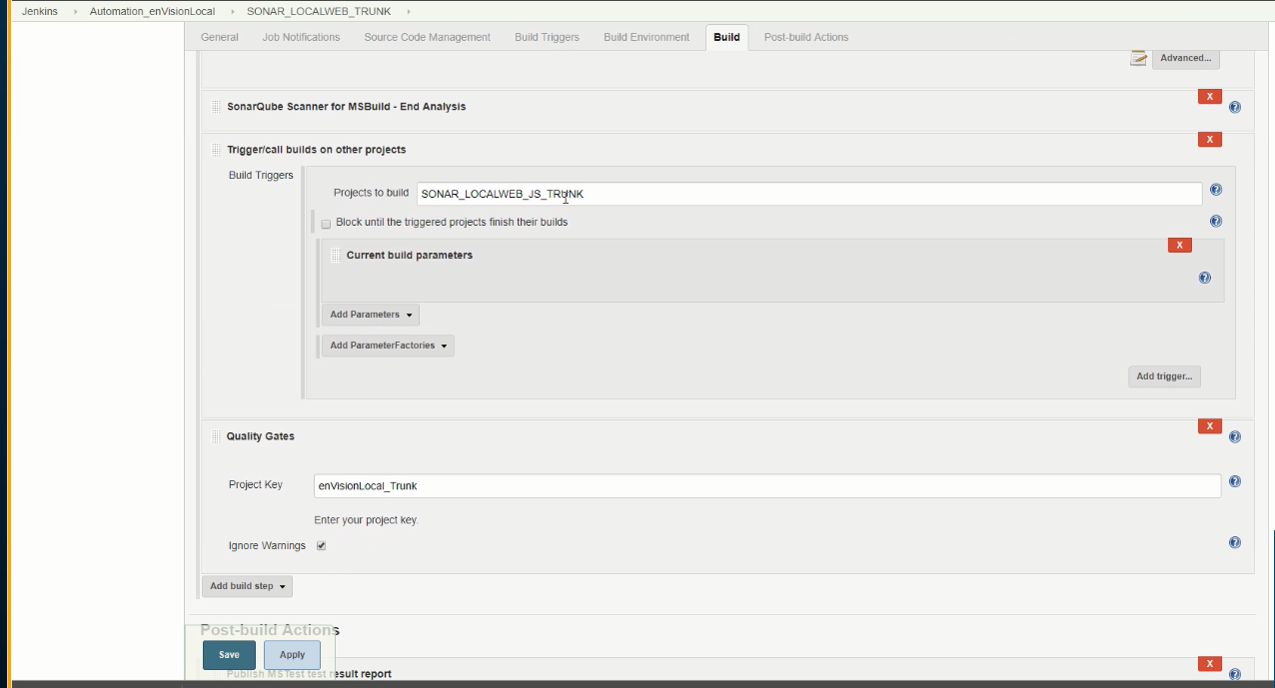

Slide 32
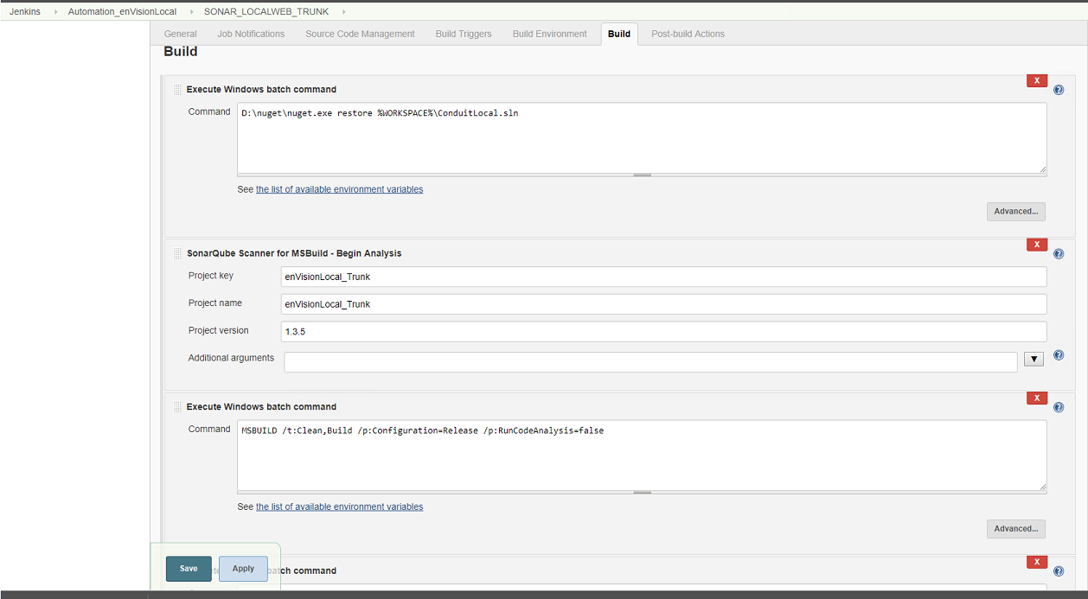

Slide 33
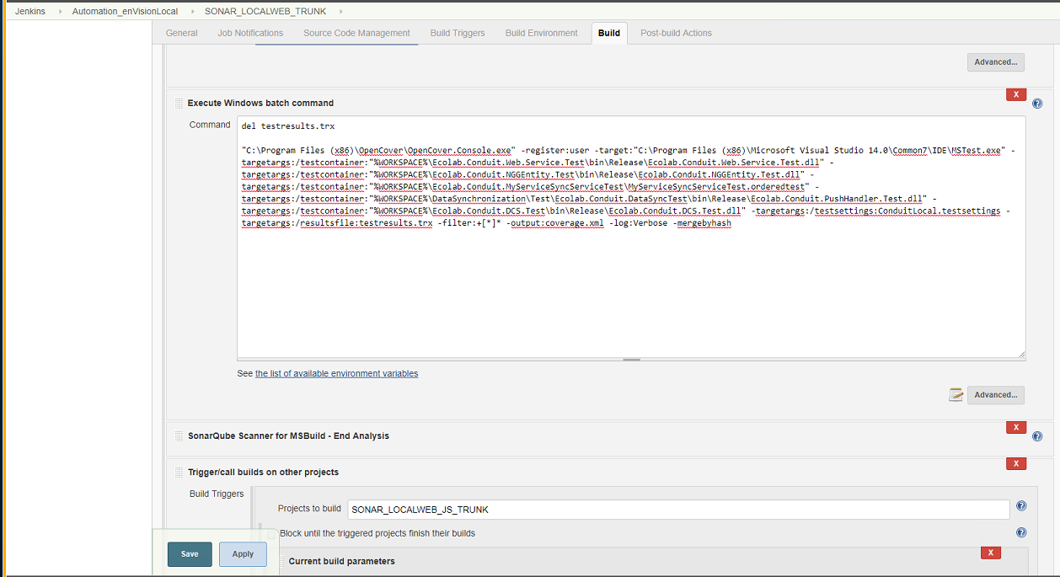

Slide 34
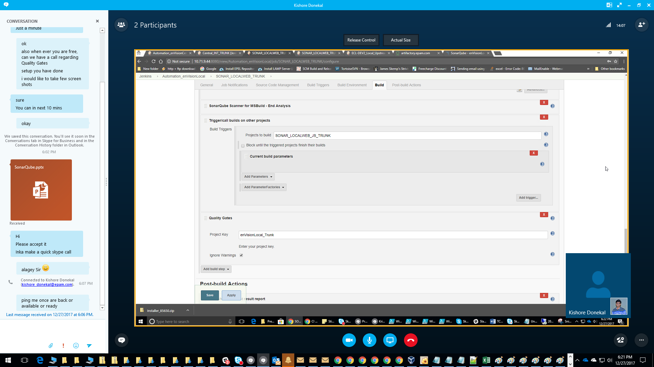

Slide 35
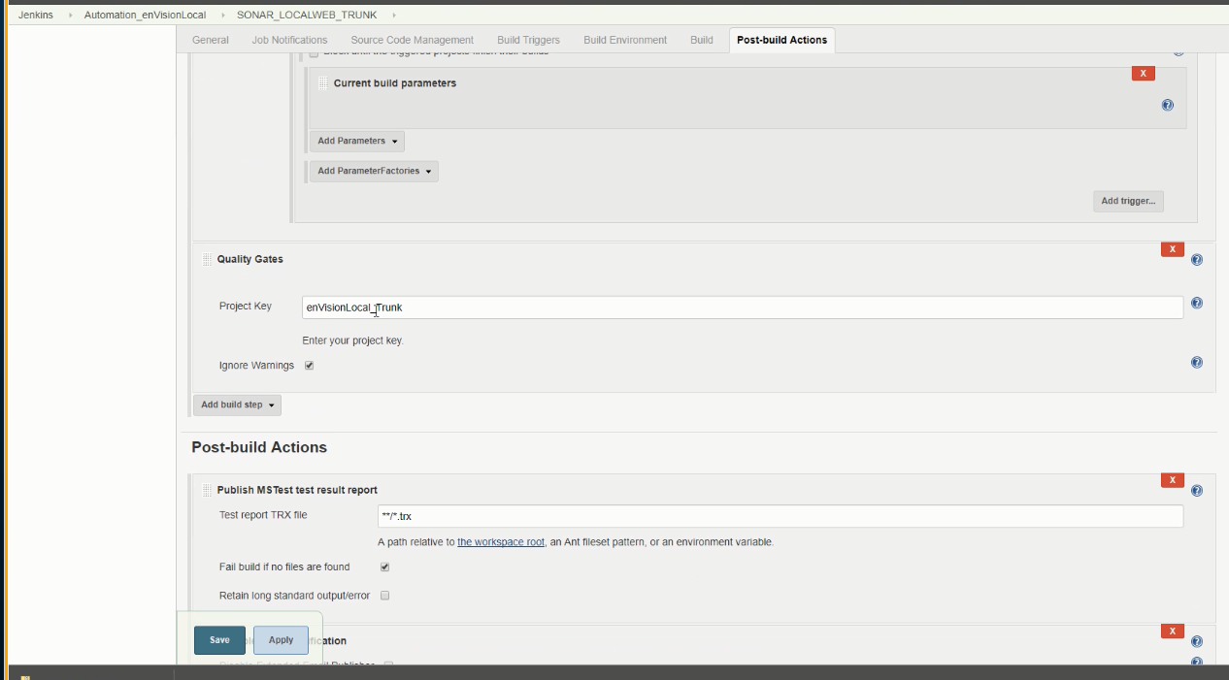

Slide 36
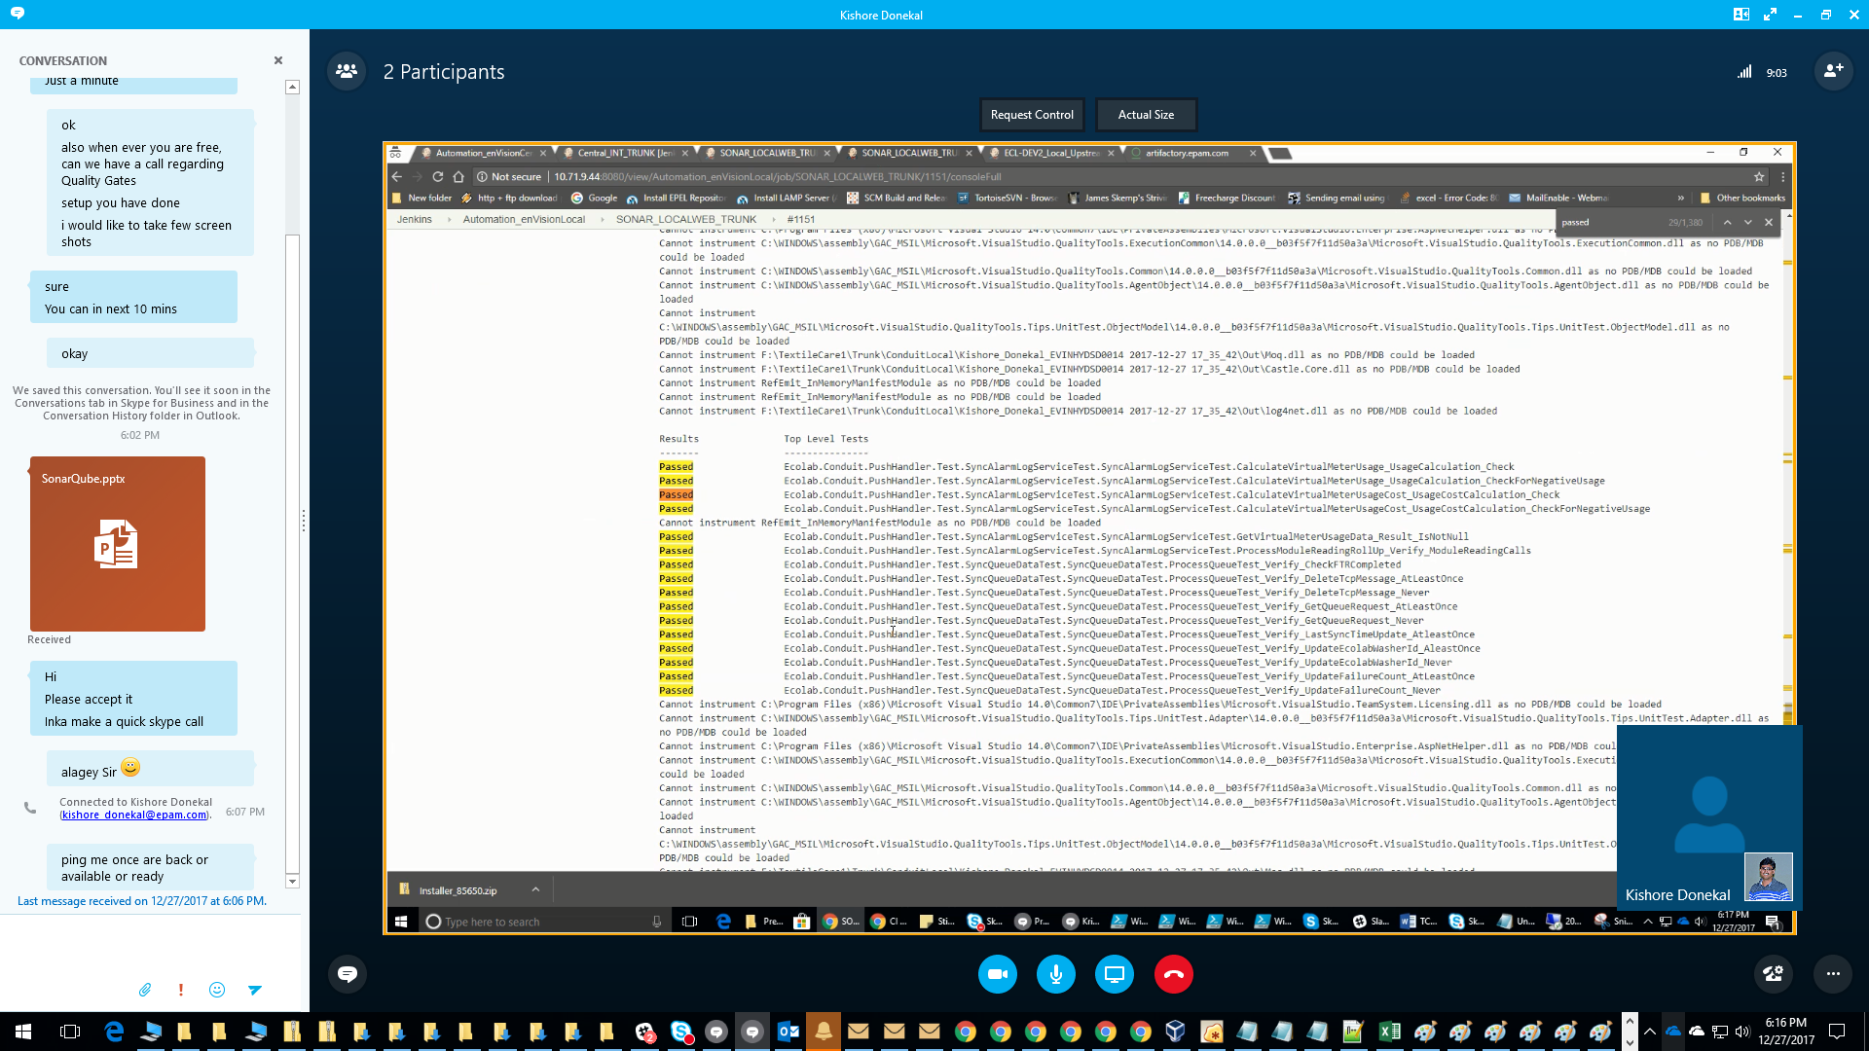

Slide 37
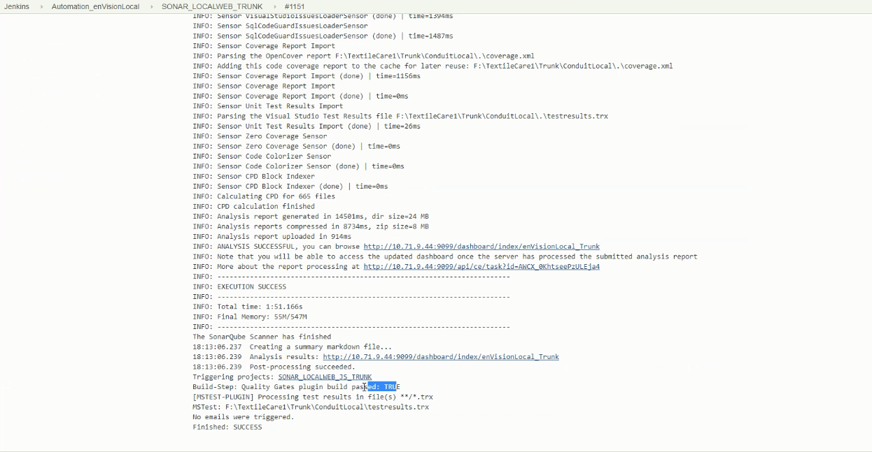

Slide 38
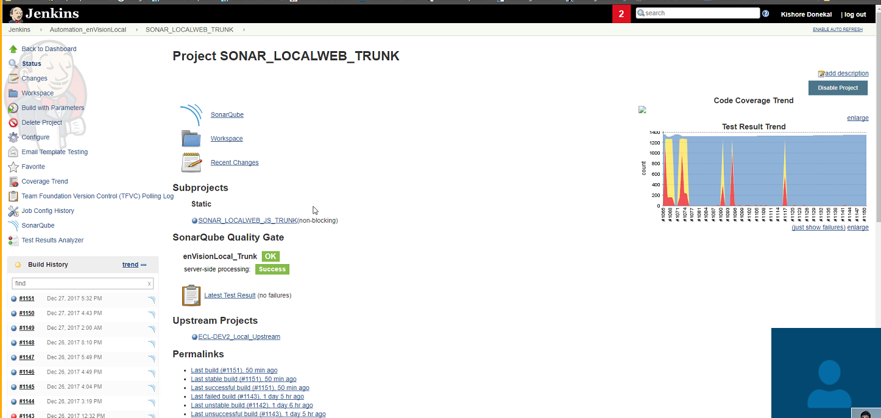

Slide 39
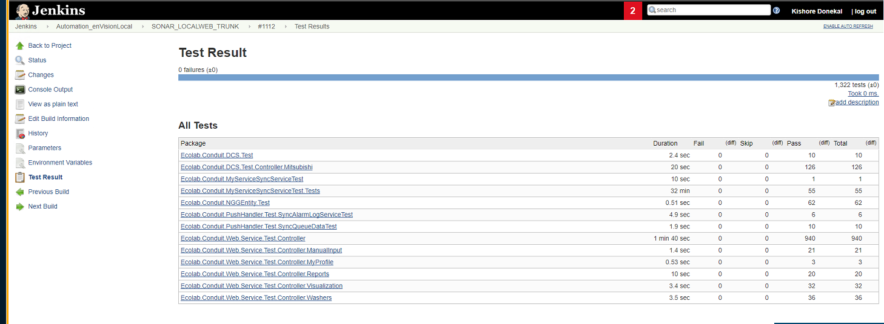

Slide 40
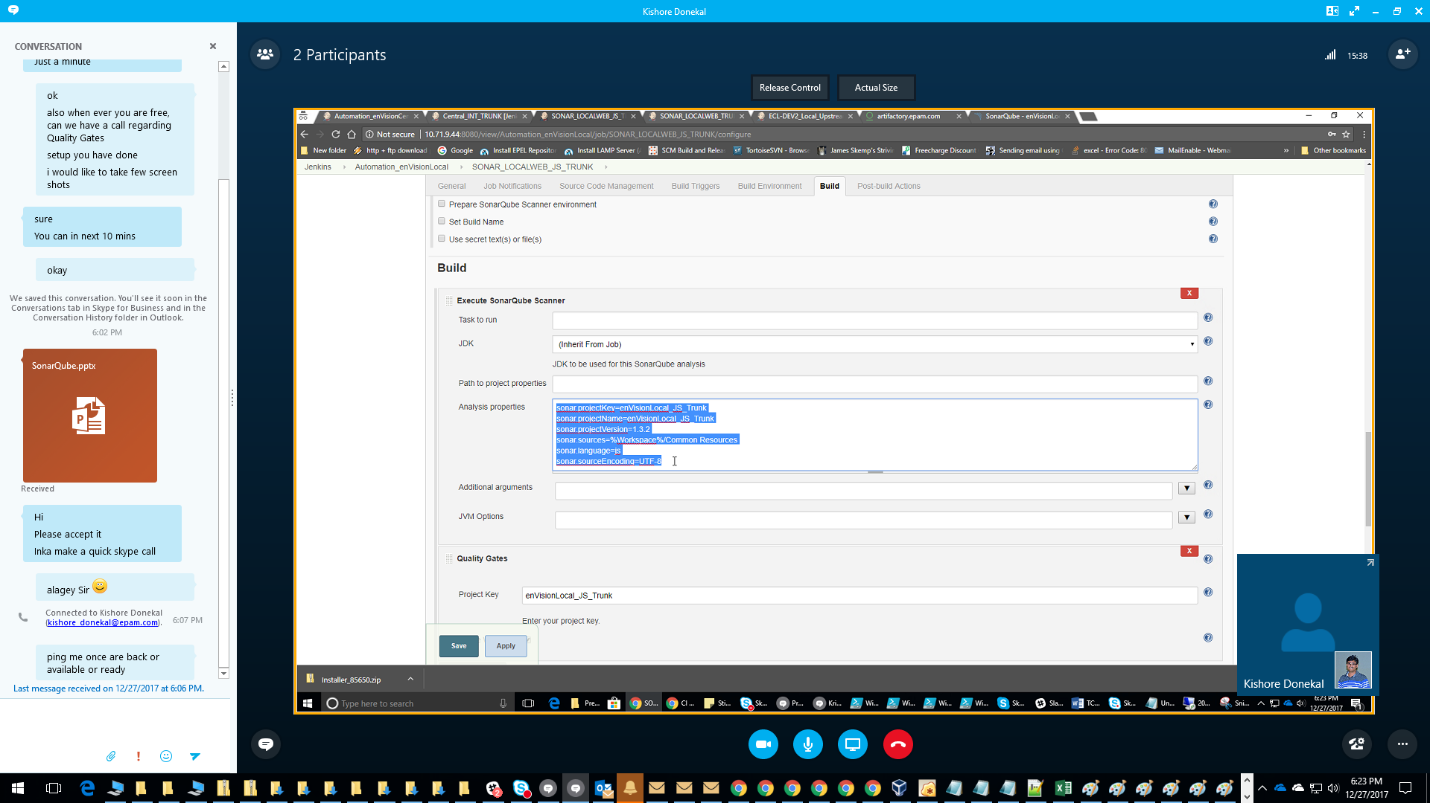
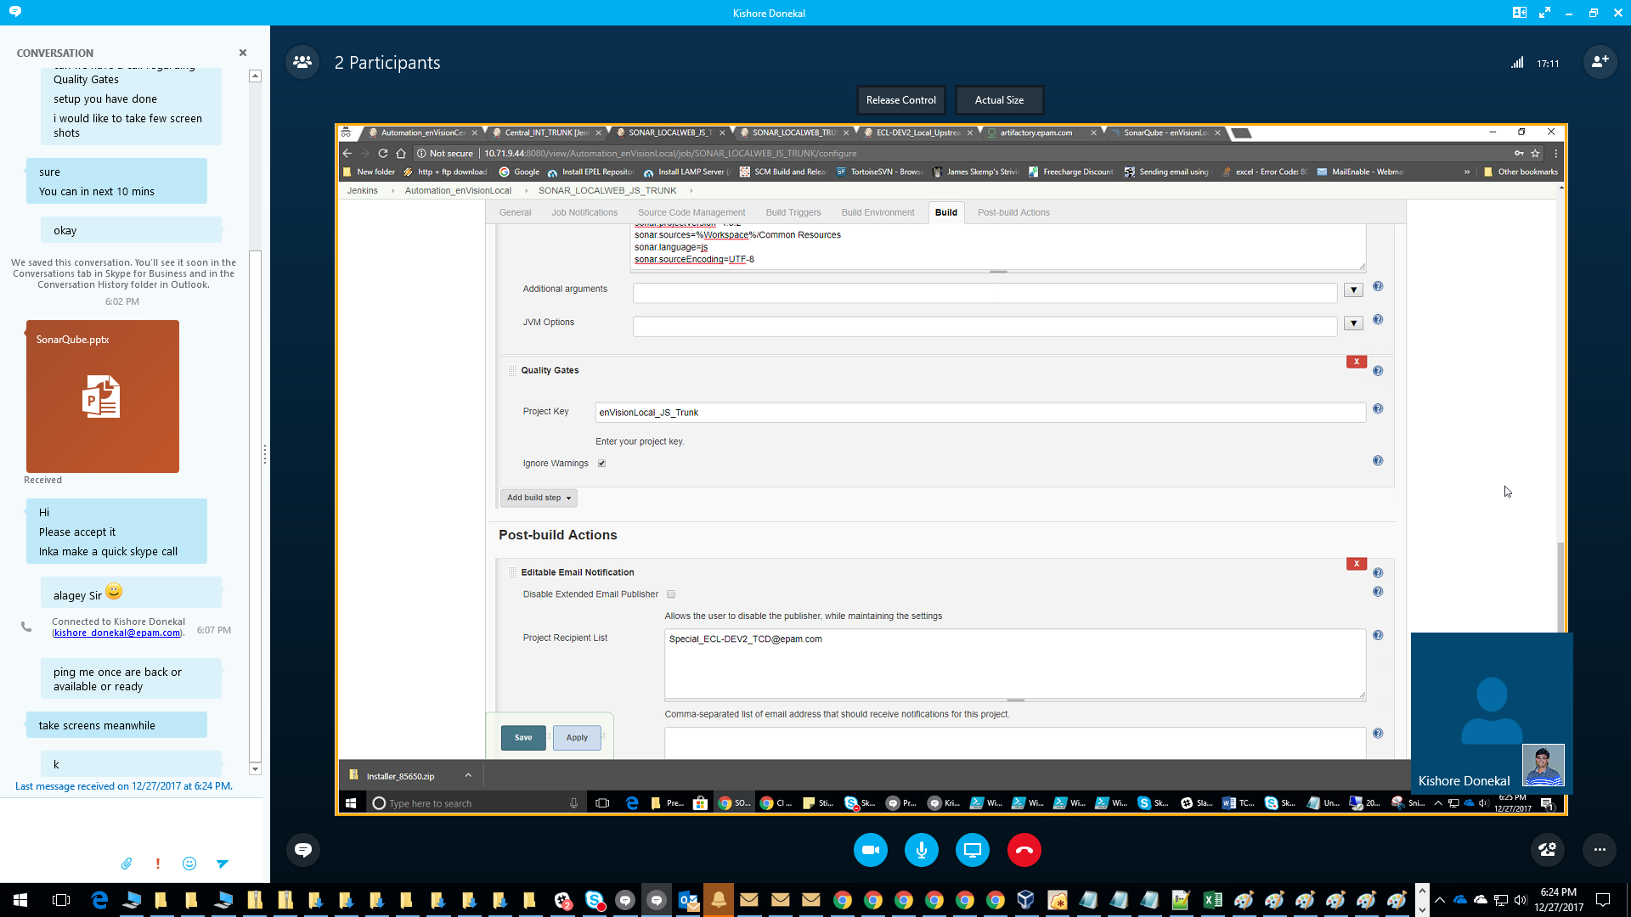

Slide 41
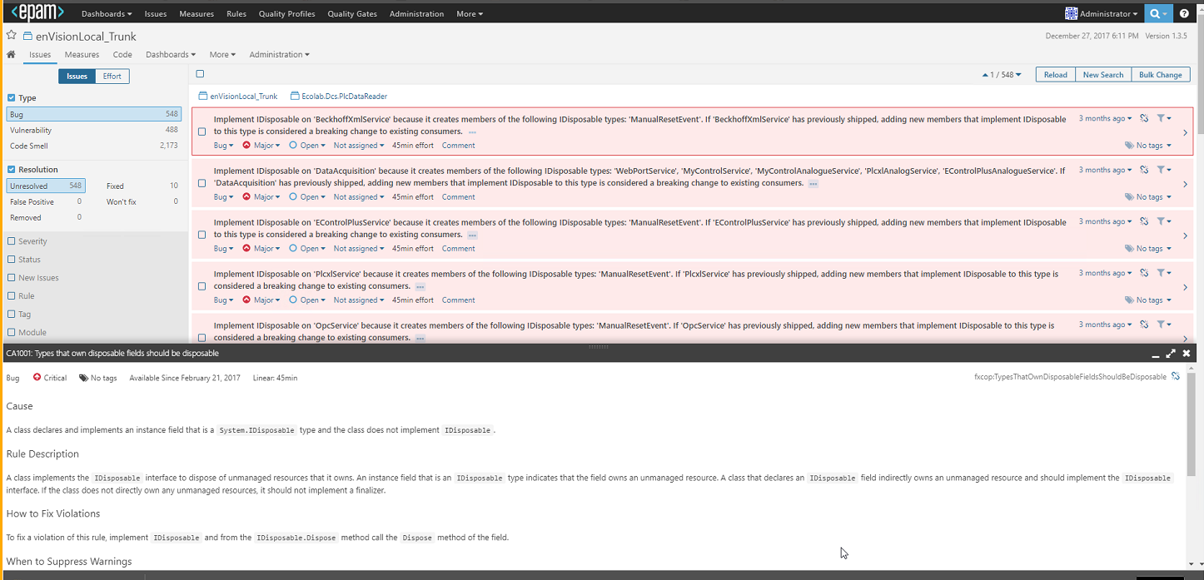

Slide 42
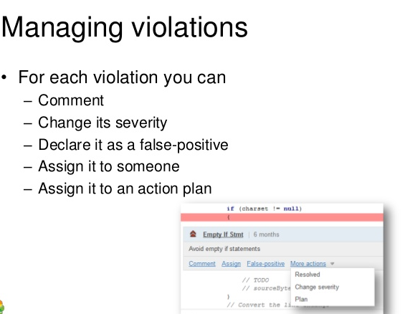

Slide 43
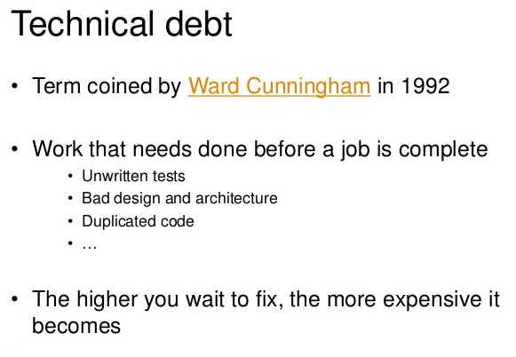

Slide 44
Metric Definition and Formula
Support and Approval Process
Technical Debt
Technical debt (also known as design debt or code debt) is a neologistic metaphor referring to the eventual consequences of poor or evolving software architecture and software development within a codebase. The debt can be thought of as work that needs to be done before a particular job can be considered complete. As a change is started on a specific codebase, there is often the need to make other coordinated changes at the same time in other parts of the codebase or documentation. The other required, but incomplete changes, are considered debt that must be paid at some point in the future.
Formula:
Debt(in man days) | cost_to_fix_duplications + cost_to_fix_violations + cost_to_comment_public_API + cost_to_fix_uncovered_complexity + cost_to_bring_complexity_below_threshold + cost_to_cut_cycles_at_package_level

Slide 45
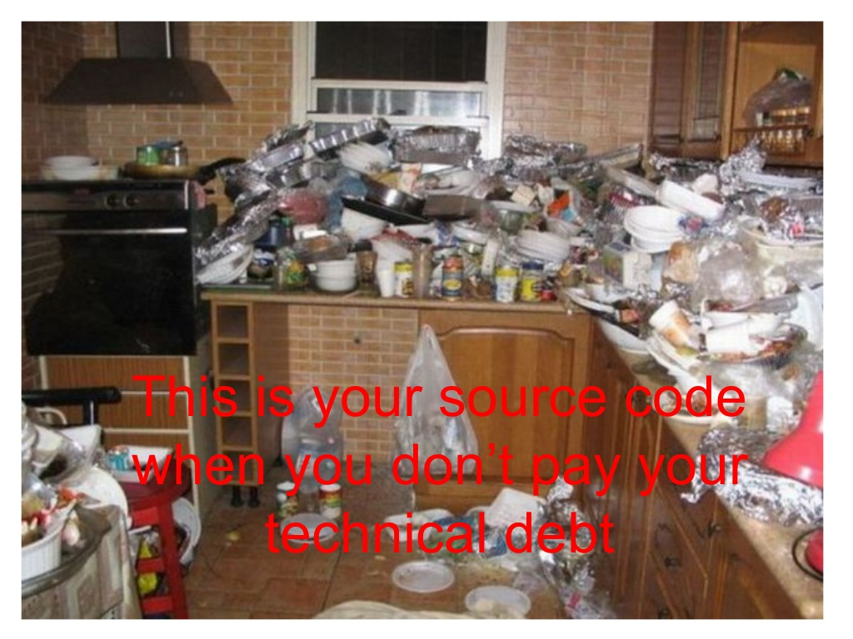

Slide 46
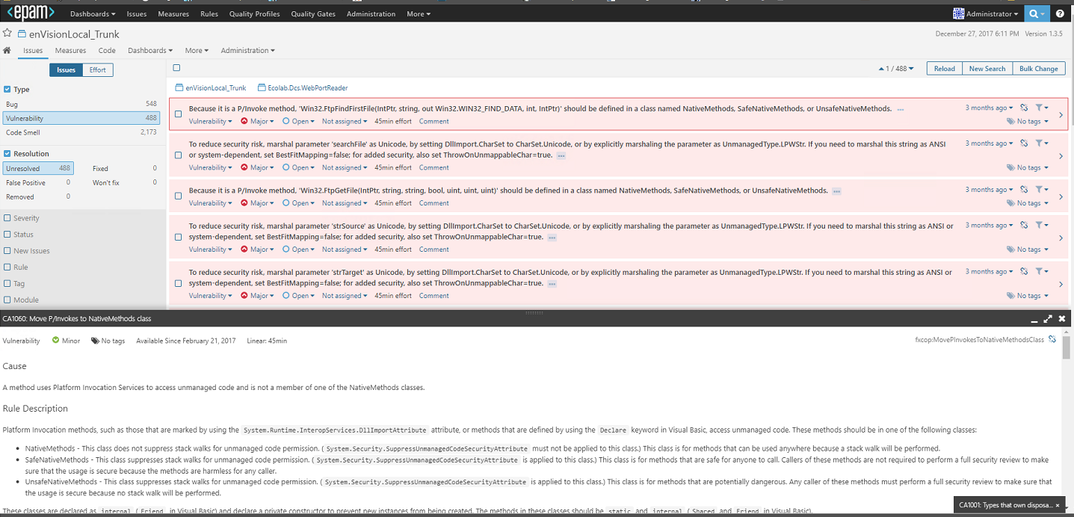

Slide 47
Metric Definition and Formula
Support and Approval Process
Violations
Hundreds of rules are configured for each language (Java, C# etc.) and violations of these rules are reported based on the severity in SONAR implementation. These rules are based on PMC, CheckStyle, FxCop etc.
Recommendations:
Violation Type | Alliance Tolerance
Blocker | 0
Critical | 0
Major | <25
Minor | <50

Slide 48
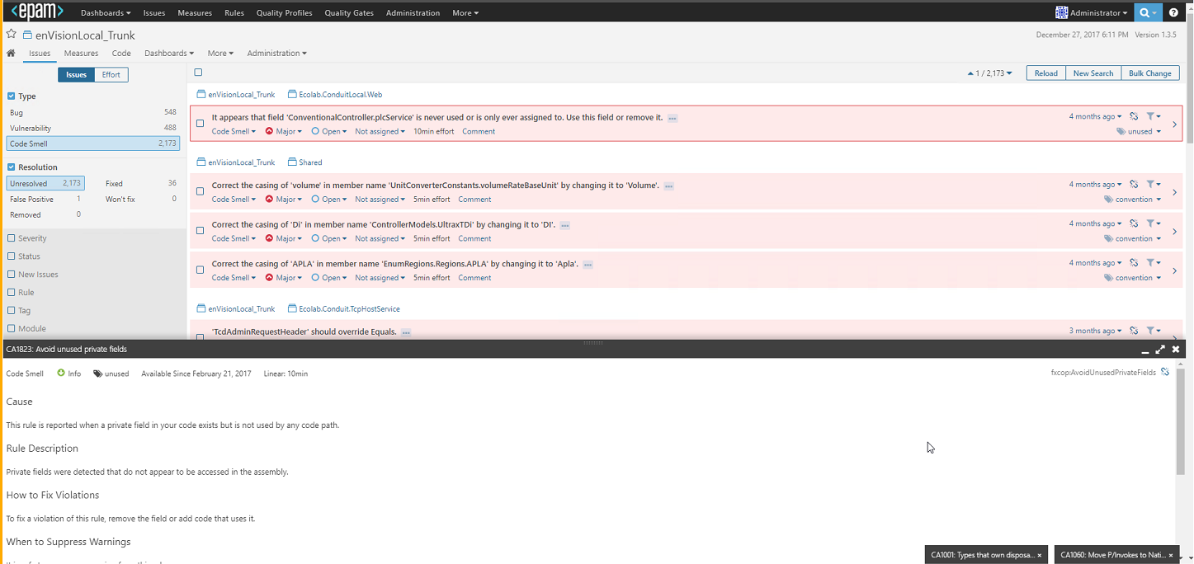

Slide 49
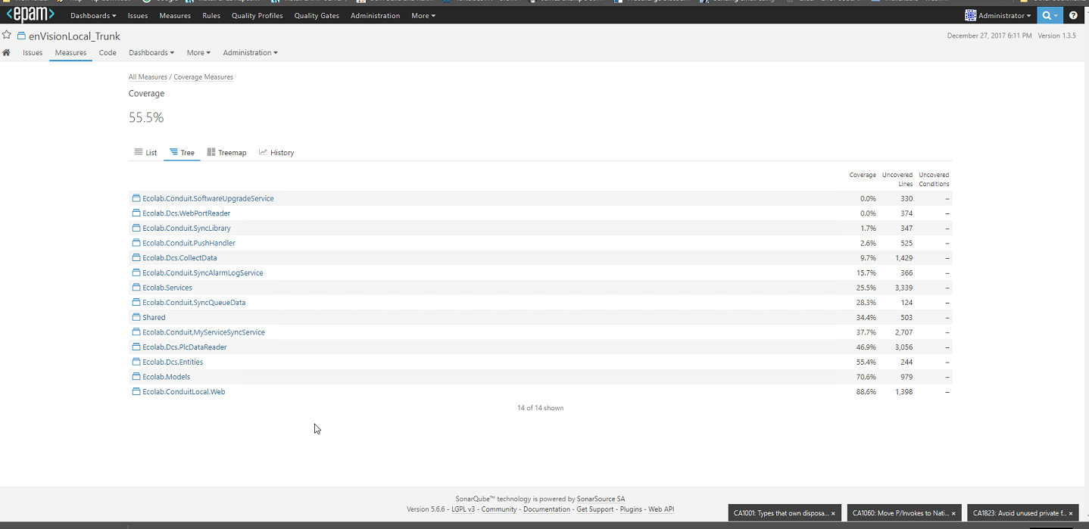

Slide 50
Metric Definition and Formula
Support and Approval Process
Unit Test Coverage
The percentage of code coverage by tests that are defined for application, types, methods, branch and lines) is measured in terms of unit test coverage. Code coverage data is imported from coverage files.
Recommendations: The closer to 100%, the better. But more than %, having valuable unit tests is more important. It’s not always the % important because it is hard to write unit tests for the entire code. So Alliance’s recommendation has been set to 80%.

Slide 51
Metric Definition and Formula
Support and Approval Process
Unit Test Run Success Rate
Unit Test Run Success Rate indicates the number of the unit tests that ran successfully during the Unit Test execution on a CI Platform.
Recommendations: The closer to 100%, the better. If one or more tests fail, the build is considered as unstable. One of the three actions must be taken by the team.
1. Fix the code to pass the unit tests.
2. Fix the unit test as the failed unit test could be related to a change in the requirement that makes the unit test fail.
3. Mute or remove the unit test as the unit test is no longer relevant due to a change in the requirement.

Slide 52
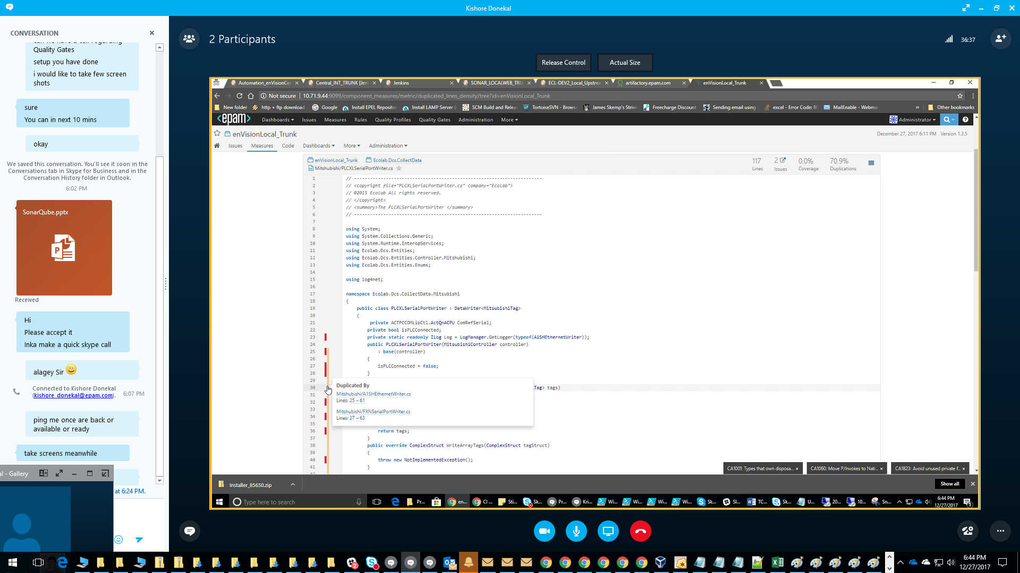

Slide 53
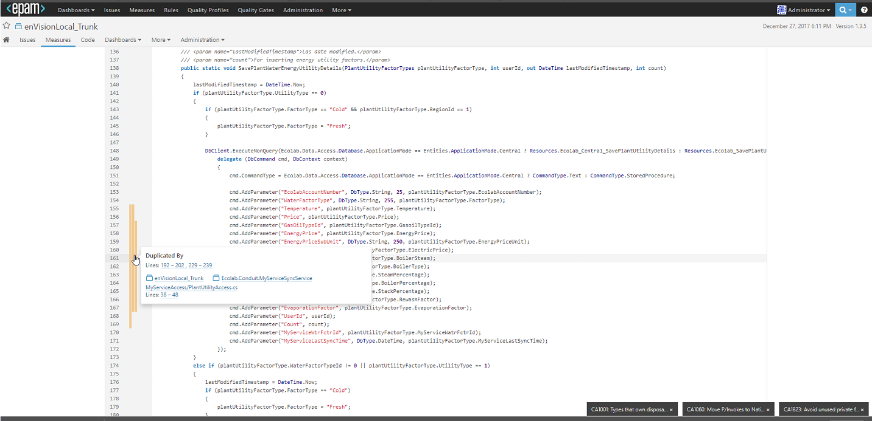

Slide 54
Metric Definition and Formula
Support and Approval Process
Duplicate Code %
Duplicate code could be a result of copy/paste from an existing piece of code or due to the code generated by a tool or could be result of other actions. But it is very important to track and eliminate duplicate code as the side effects of duplicate codes are bad.
To help you understand duplicate code better. Please follow the below.
Code fragment (code region / portion / segment) is any sequence of code. It can be of any granularity, e.g., function definition, begin-end block, sequence of statements or sequence of tokens.
A code fragment CF2 is a duplication of another code fragment CF1 if they are similar by some given definition of similarity, that is, f(CF1) = f(CF2) where f is a similar function.
Two code fragments that are similar to each other form a duplication pair (CF1, CF2) and when many fragments are similar, they form a duplication group.
We prefer term “duplicate” (“duplication”) over “clone”, because at least it doesn’t clash with a name of clone method in Java.
Recommendations: In an ideal situation, no code duplication is allowed, however a maximum of 1.5% of code duplication is considered as tolerable.

Slide 55
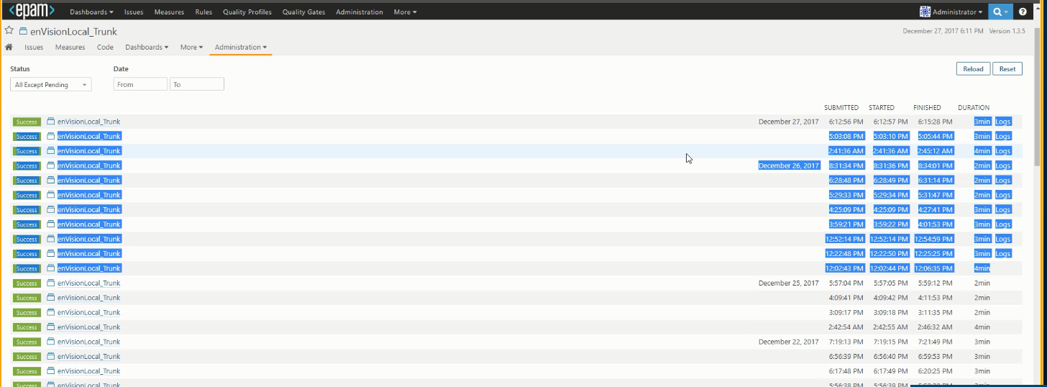

Slide 56
Metric Definition and Formula
Support and Approval Process
Cyclomatic Complexity
Cyclomatic Complexity (CC): Cyclomatic complexity is a popular procedural software metric equal to the number of decisions that can be taken in a procedure. Concretely,
The CC of a method is 1 + {the number of following expressions found in the body of the method}:
if | while | for | foreach | case | default | continue | goto | && | || | catch | ternary operator ?: | ?? Following expressions are not counted for CC computation: else | do | switch | try | using | throw | finally | return | object creation | method call | field access
The Cyclomatic Complexity metric is defined on methods (also tracked on Types as a sum of all the methods). Adapted to the OO world, this metric is also defined for classes and structures as the sum of its methods CC. Notice that the CC of an anonymous method is not counted when computing the CC of its outer method.
Recommendations: Methods where CC is higher than 15 are hard to understand and maintain. Methods where CC is higher than 30 are extremely complex and should be split in smaller methods (except if they are automatically generated by a tool).

Slide 57
Metric Definition and Formula
Support and Approval Process
Percentage Comment
Percentage of code commented by the developer to help the reader understand what the intent of the code. This is defined for application, assemblies, namespaces, types, methods. This metric is computed with the following formula:
PercentageComment = Comment lines / (Lines of code + Comment lines) * 100
Recommendations: Code where the percentage of comment is lower than 15% should be more commented. However overly commented code (>30%) is not necessarily a blessing as it can pose changes of keeping the comments updated. Specifically if a code is written all the AllianceWay best practices, the code itself becomes more readable and the need of commenting reduces. Having the code comments updated is very important and not having the updated code comments is worse than not having any code comments.
It is highly recommend to have comments when you think the code or decisions made in the code are not self-explanatory or the code is complex to understand.

Slide 58
Metric Definition and Formula
Support and Approval Process
Rules Compliance
The Rules Compliance is one single number that indicates at what magnitude the good practices and standards are not being followed.
Formula: Rules compliance index (RCI) = 100 - (Weighted issues/ Lines of code * 100)
Recommendations: Closer to 100% is better, but EPAM recommended index is > 95%.

Slide 59
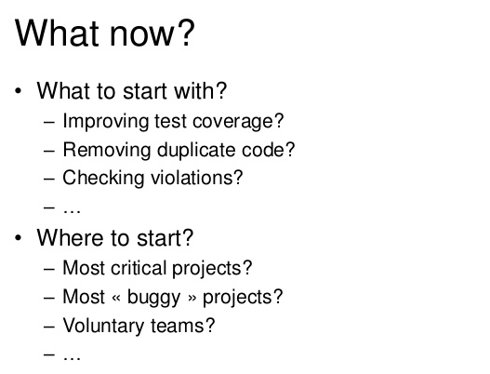

Slide 60
DEMO

Slide 61

THANK YOU!

